Slide 1
13
The Peripheral Nervous System and Reflex Activity: Part B

Slide 2
Cranial Nerves
Twelve pairs of nerves associated with brain
  Two attach to forebrain; rest with brain stem
Most mixed nerves; two pairs purely sensory
Each numbered (I through XII) and named from rostral to caudal
"On occasion, our trusty truck acts funny—very good vehicle anyhow"
"Oh once one takes the anatomy final, very good vacations are heavenly"

Slide 3
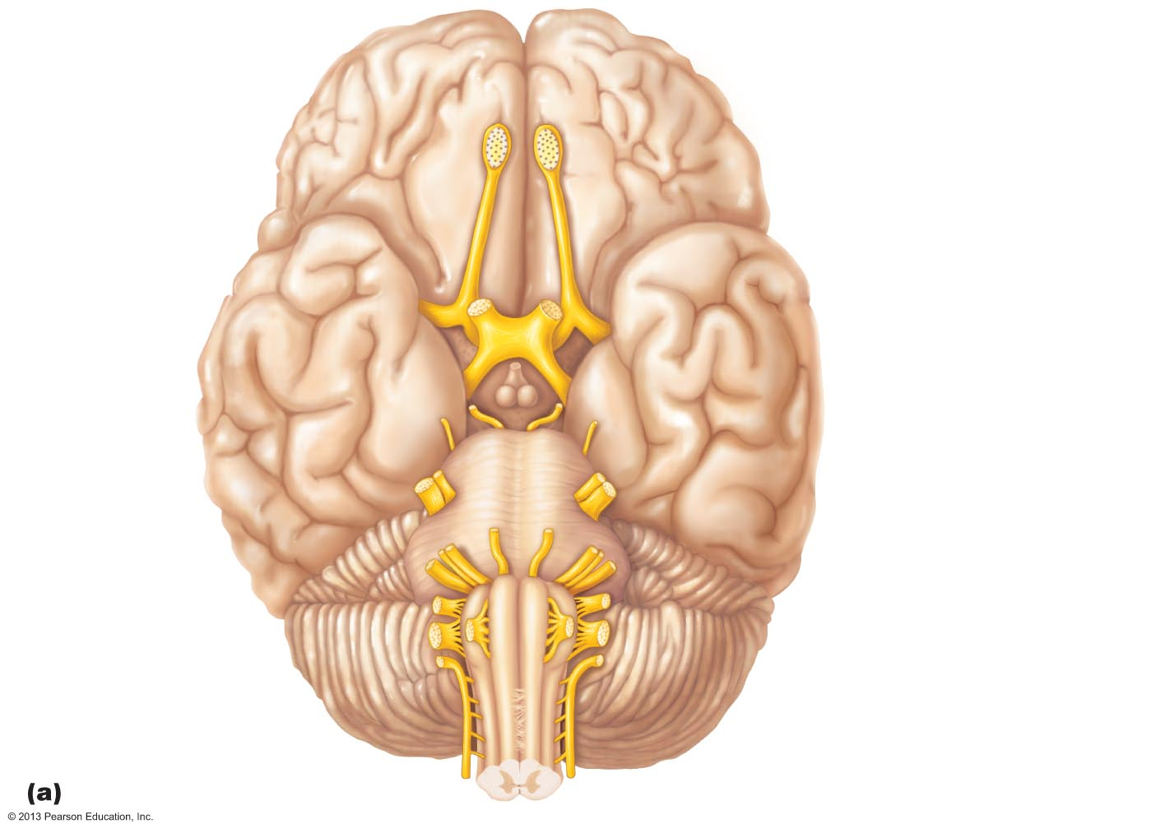
Figure 13.6a Location and function of cranial nerves.
Filaments of
olfactory nerve (I)
Frontal lobe
Olfactory bulb
Olfactory tract
Optic nerve (II)
Temporal lobe
Optic chiasma
Optic tract
Oculomotor
nerve (III)
Infundibulum
Trochlear
nerve (IV)
Facial nerve (VII)
Trigeminal
nerve (V)
Vestibulocochlear
nerve (VIII)
Abducens
nerve (VI)
Glossopharyngeal
nerve (IX)
Cerebellum
Vagus nerve (X)
Accessory nerve (XI)
Medulla oblongata
Hypoglossal nerve (XII)

Slide 4
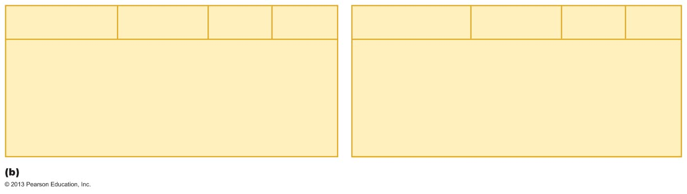
Figure 13.6b Location and function of cranial nerves.
Cranial nerves
I – VI
Sensory
function
Motor
function
PS*
fibers
Cranial nerves
VII – XII
Sensory
function
Motor
function
PS*
fibers
I
II
III
IV
V
VI
Olfactory
Optic
Oculomotor
Trochlear
Trigeminal
Abducens
Yes (smell)
Yes (vision)
No
No
Yes (general
sensation)
No
No
No
Yes
Yes
Yes
Yes
No
No
Yes
No
No
No
VII
VIII
IX
X
XI
XII
Facial
Vestibulocochlear
Glossopharyngeal
Vagus
Accessory
Hypoglossal
Yes (taste)
Yes (hearing
and balance)
Yes (taste)
Yes (taste)
No
No
Yes
Some
Yes
Yes
Yes
Yes
Yes
No
Yes
Yes
No
No
*PS = parasympathetic

Slide 5
I: The Olfactory Nerves
Sensory nerves of smell
Run from nasal mucosa to olfactory bulbs
Pass through cribriform plate of ethmoid bone
Fibers synapse in olfactory bulbs
Pathway terminates in primary olfactory cortex
Purely sensory (olfactory) function

Slide 6
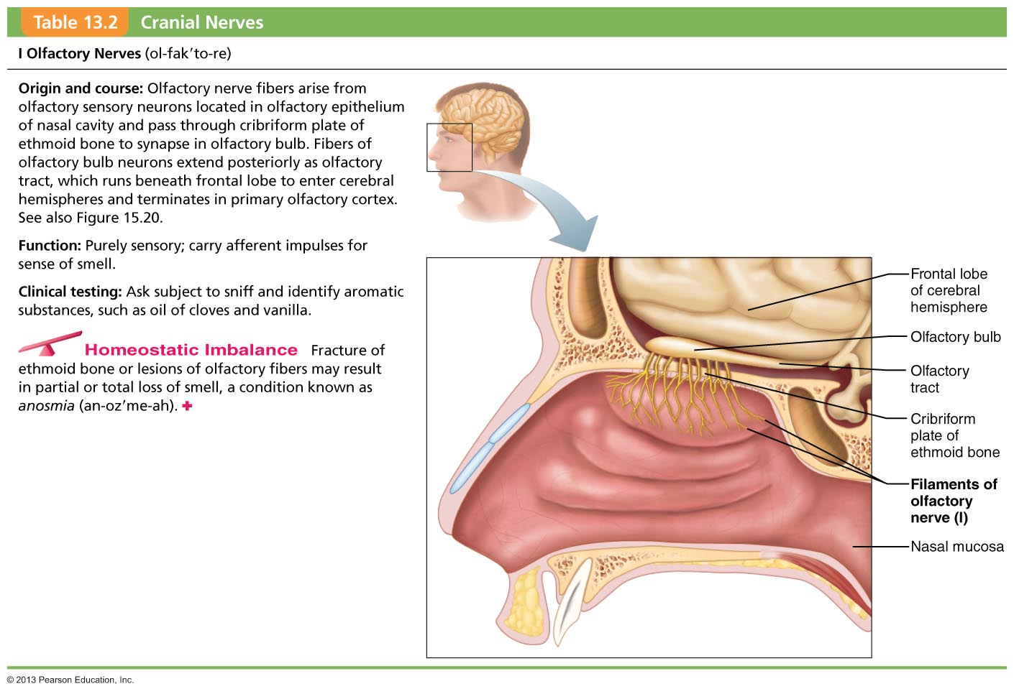
Table 13.2 Cranial Nerves (1 of 14)

Slide 7
II: The Optic Nerves
Arise from retinas; really a brain tract
Pass through optic canals, converge and partially cross over at optic chiasma
Optic tracts continue to thalamus, where they synapse
Optic radiation fibers run to occipital (visual) cortex
Purely sensory (visual) function

Slide 8
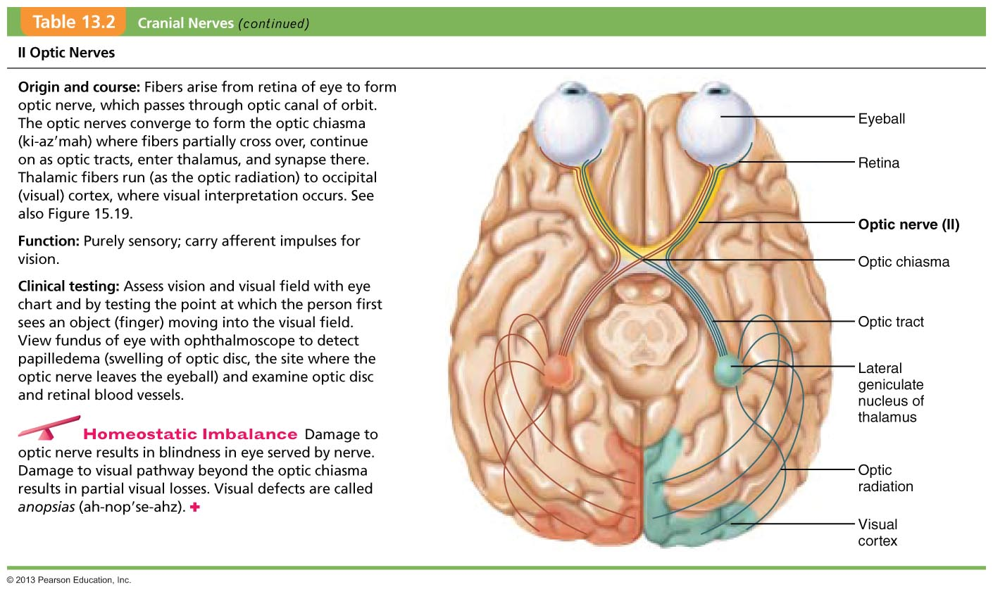
Table 13.2 Cranial Nerves (2 of 14)

Slide 9
III: The Oculomotor Nerves
Fibers extend from ventral midbrain through superior orbital fissures to four of six extrinsic eye muscles
Function in raising eyelid, directing eyeball, constricting iris (parasympathetic), and controlling lens shape

Slide 10
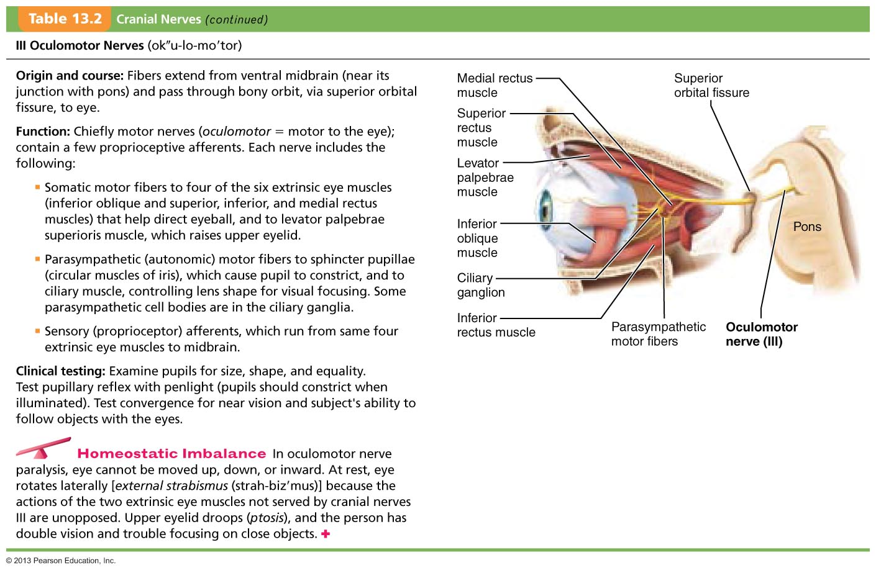
Table 13.2 Cranial Nerves (3 of 14)

Slide 11
IV: The Trochlear Nerves
Fibers from dorsal midbrain enter orbits via superior orbital fissures to innervate superior oblique muscle
Primarily motor nerve that directs eyeball

Slide 12
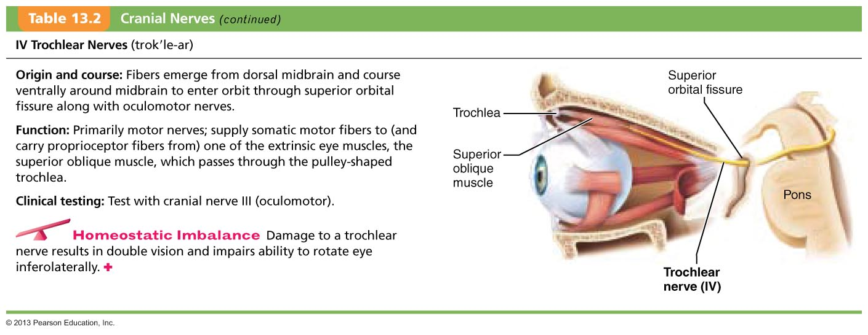
Table 13.2 Cranial Nerves (4 of 14)

Slide 13
V: The Trigeminal Nerves
Largest cranial nerves; fibers extend from pons to face
Three divisions
  Ophthalmic (V₁) passes through superior orbital fissure
  Maxillary (V₂) passes through foramen rotundum
  Mandibular (V₃) passes through the foramen ovale
Convey sensory impulses from various areas of face (V₁) and (V₂)
Supply motor fibers (V₃) for mastication

Slide 14
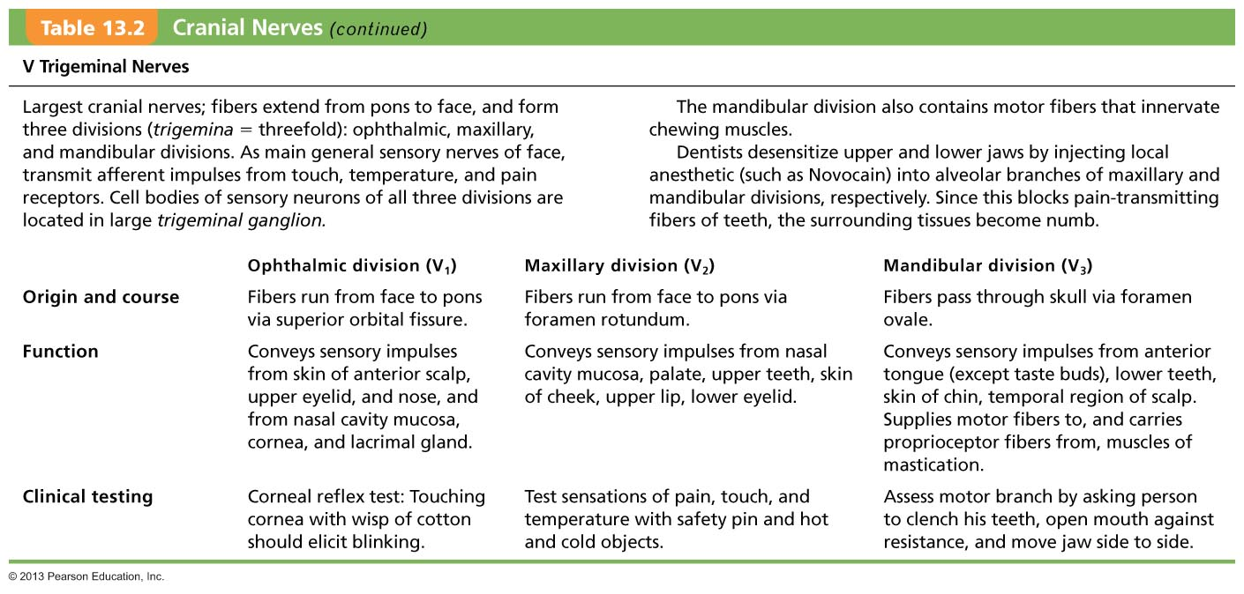
Table 13.2 Cranial Nerves (5 of 14)

Slide 15
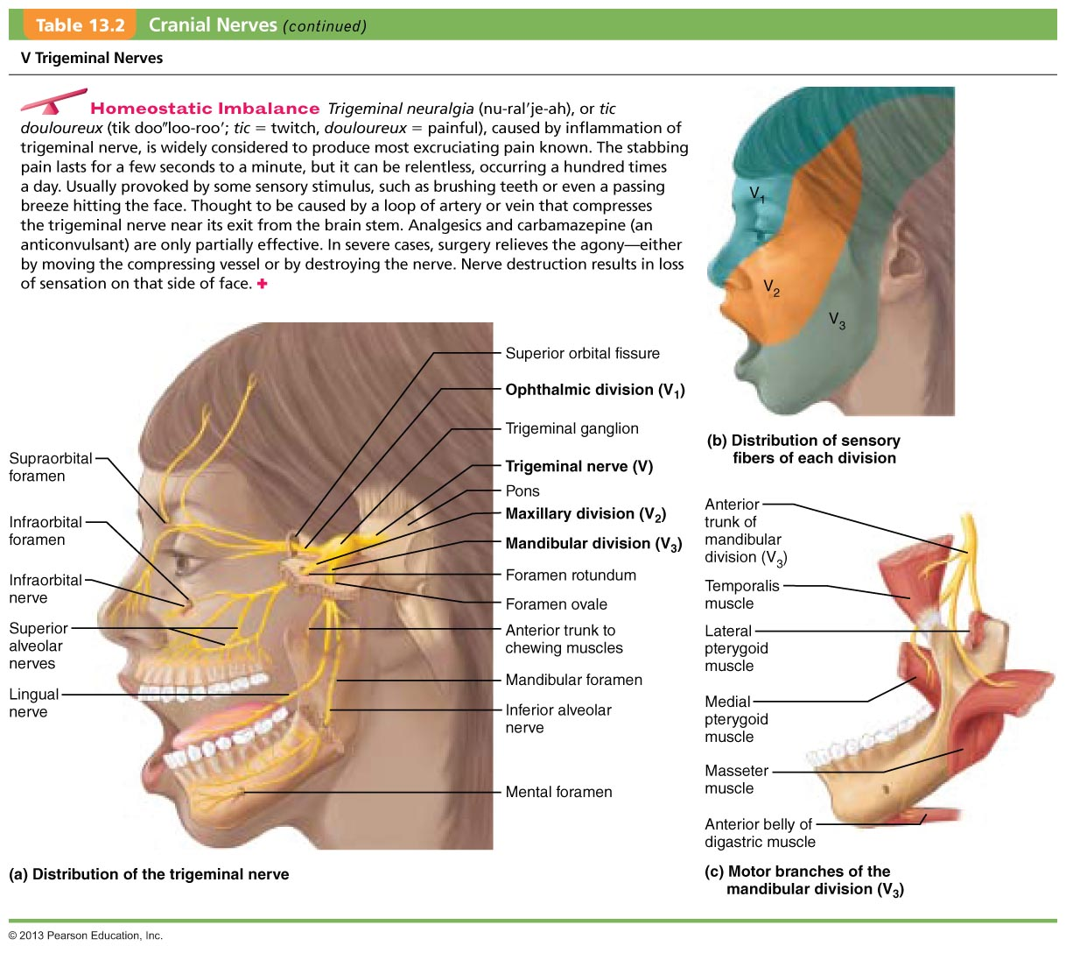
Table 13.2 Cranial Nerves (6 of 14)

Slide 16
VI: The Abducens Nerves
Fibers from inferior pons enter orbits via superior orbital fissures
Primarily a motor, innervating lateral rectus muscle

Slide 17
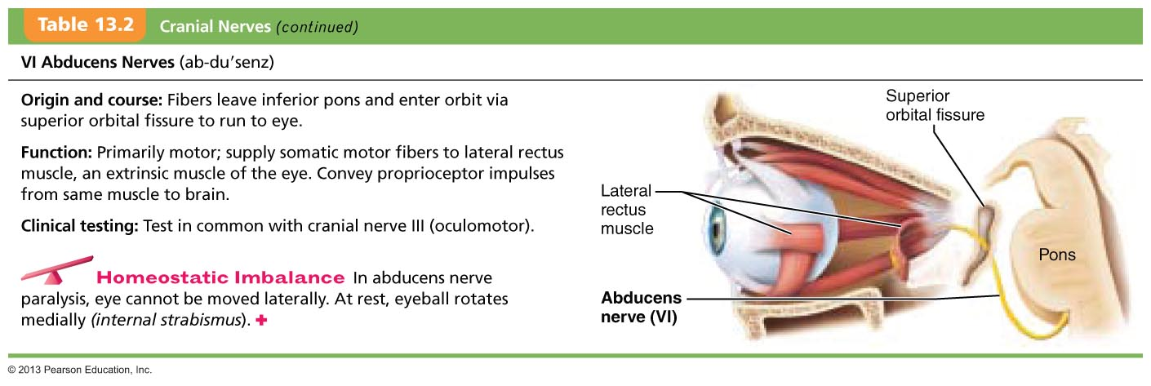
Table 13.2 Cranial Nerves (7 of 14)

Slide 18
VII: The Facial Nerves
Fibers from pons travel through internal acoustic meatuses, and emerge through stylomastoid foramina to lateral aspect of face
Chief motor nerves of face with 5 major branches
Motor functions include facial expression, parasympathetic impulses to lacrimal and salivary glands
Sensory function (taste) from anterior two-thirds of tongue

Slide 19
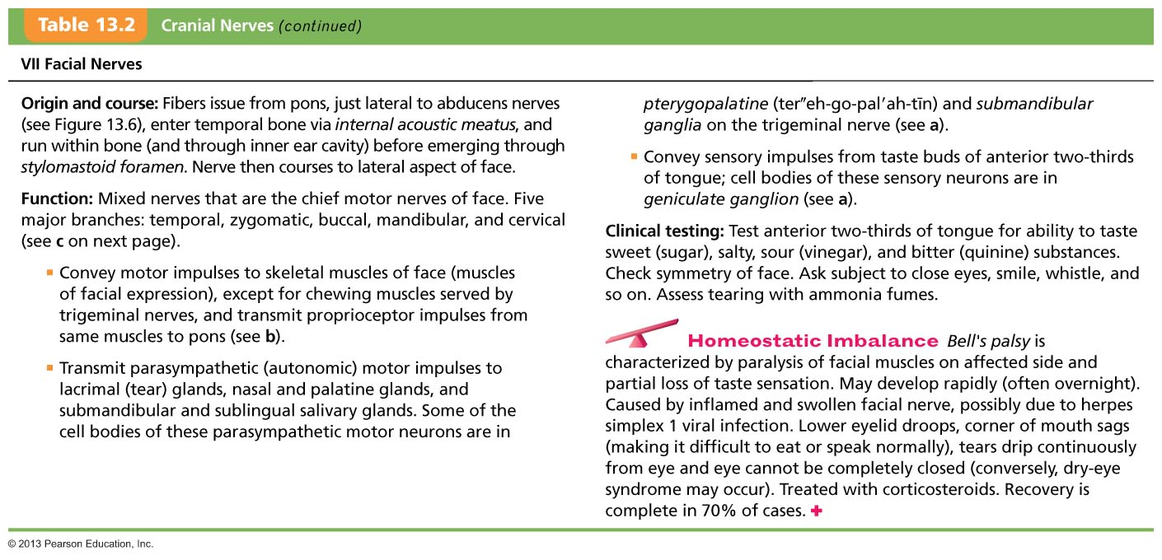
Table 13.2 Cranial Nerves (8 of 14)

Slide 20
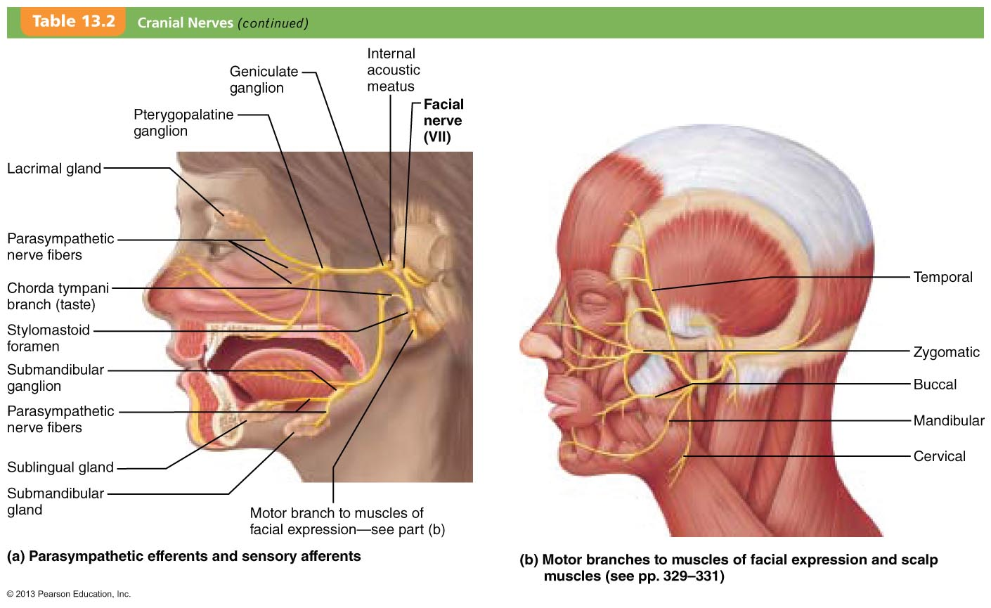
Table 13.2 Cranial Nerves (9 of 14)

Slide 21
VIII: The Vestibulocochlear Nerves
Afferent fibers from hearing receptors (cochlear division) and equilibrium receptors (vestibular division) pass from inner ear through internal acoustic meatuses, and enter brain stem at pons-medulla border
Mostly sensory function; small motor component for adjustment of sensitivity of receptors
Formerly auditory nerve

Slide 22
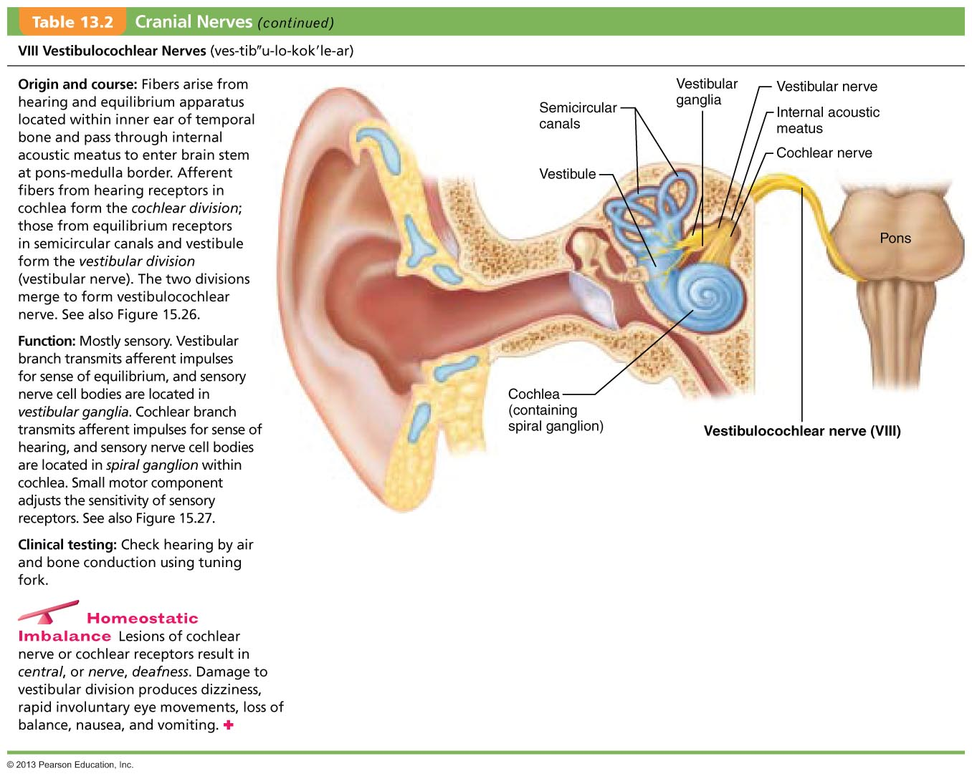
Table 13.2 Cranial Nerves (10 of 14)

Slide 23
IX: The Glossopharyngeal Nerves
Fibers from medulla leave skull via jugular foramen and run to throat
Motor functions - innervate part of tongue and pharynx for swallowing, and provide parasympathetic fibers to parotid salivary glands
Sensory functions - fibers conduct taste and general sensory impulses from pharynx and posterior tongue, and impulses from carotid chemoreceptors and baroreceptors

Slide 24
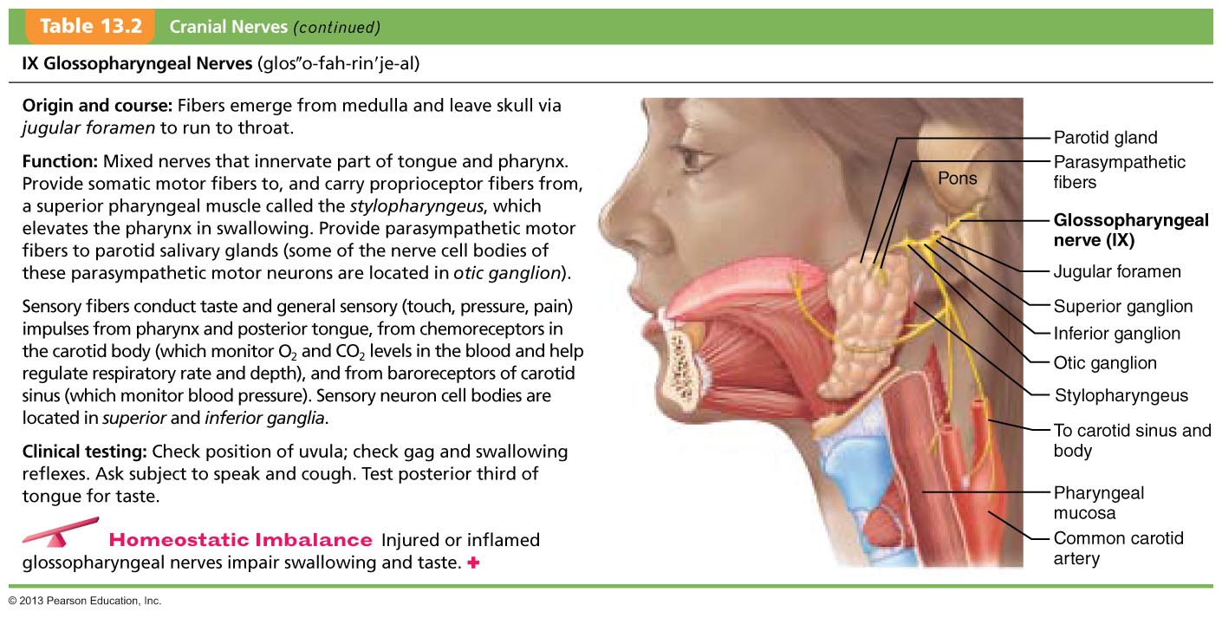
Table 13.2 Cranial Nerves (11 of 14)

Slide 25
X: The Vagus Nerves
Only cranial nerves that extend beyond head and neck region
Fibers from medulla exit skull via jugular foramen
Most motor fibers are parasympathetic fibers that help regulate activities of heart, lungs, and abdominal viscera
Sensory fibers carry impulses from thoracic and abdominal viscera, baroreceptors, chemoreceptors, and taste buds of posterior tongue and pharynx

Slide 26
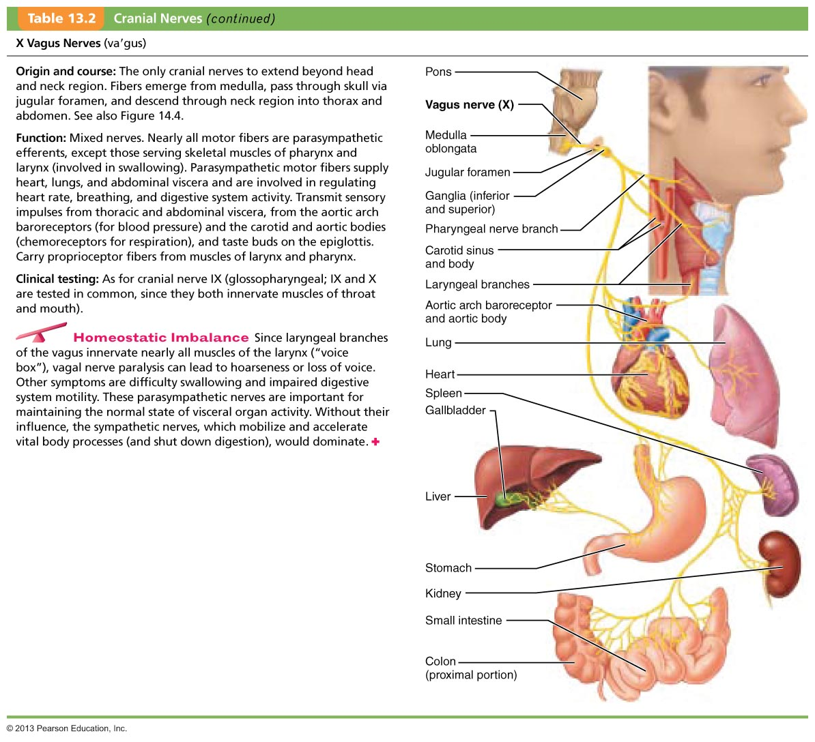
Table 13.2 Cranial Nerves (12 of 14)

Slide 27
XI: The Accessory Nerves
Formed from ventral rootlets from C₁–C₅ region of spinal cord (not brain)
Rootlets pass into cranium via each foramen magnum
Accessory nerves exit skull via jugular foramina to innervate trapezius and sternocleidomastoid muscles
Formerly spinal accessory nerve

Slide 28
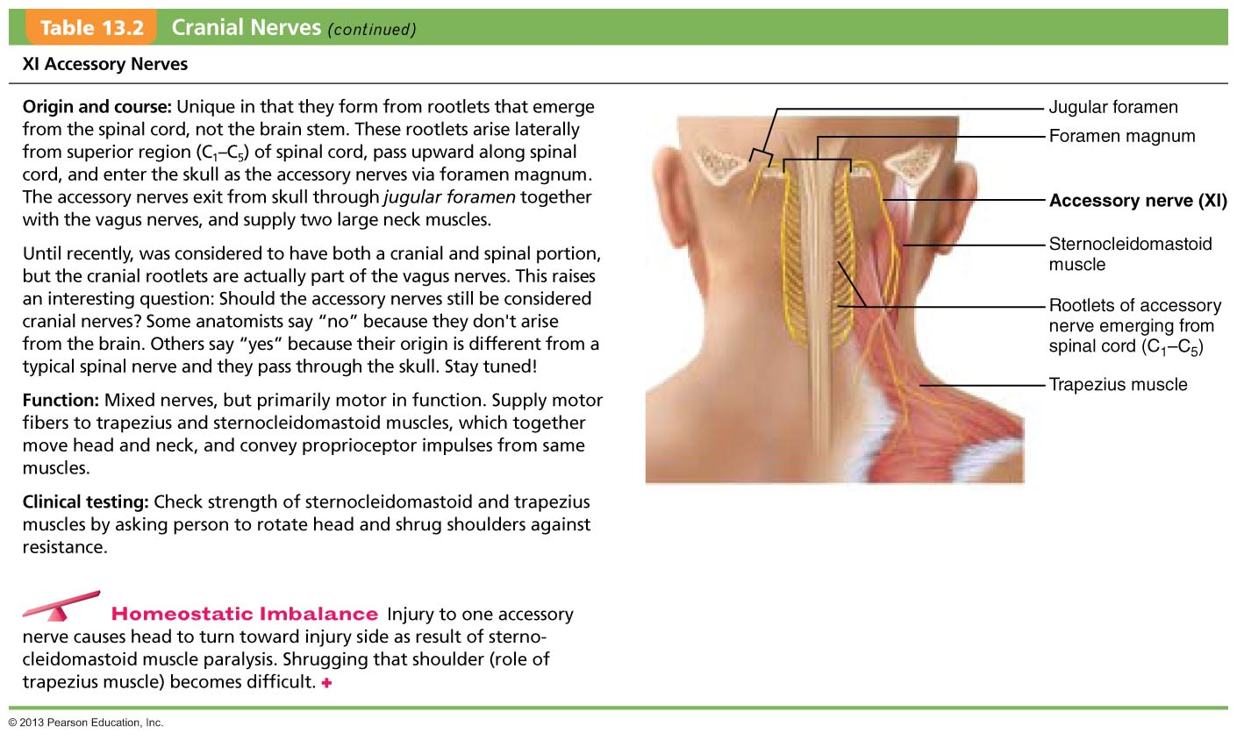
Table 13.2 Cranial Nerves (13 of 14)

Slide 29
XII: The Hypoglossal Nerves
Fibers from medulla exit skull via hypoglossal canal
Innervate extrinsic and intrinsic muscles of tongue that contribute to swallowing and speech

Slide 30
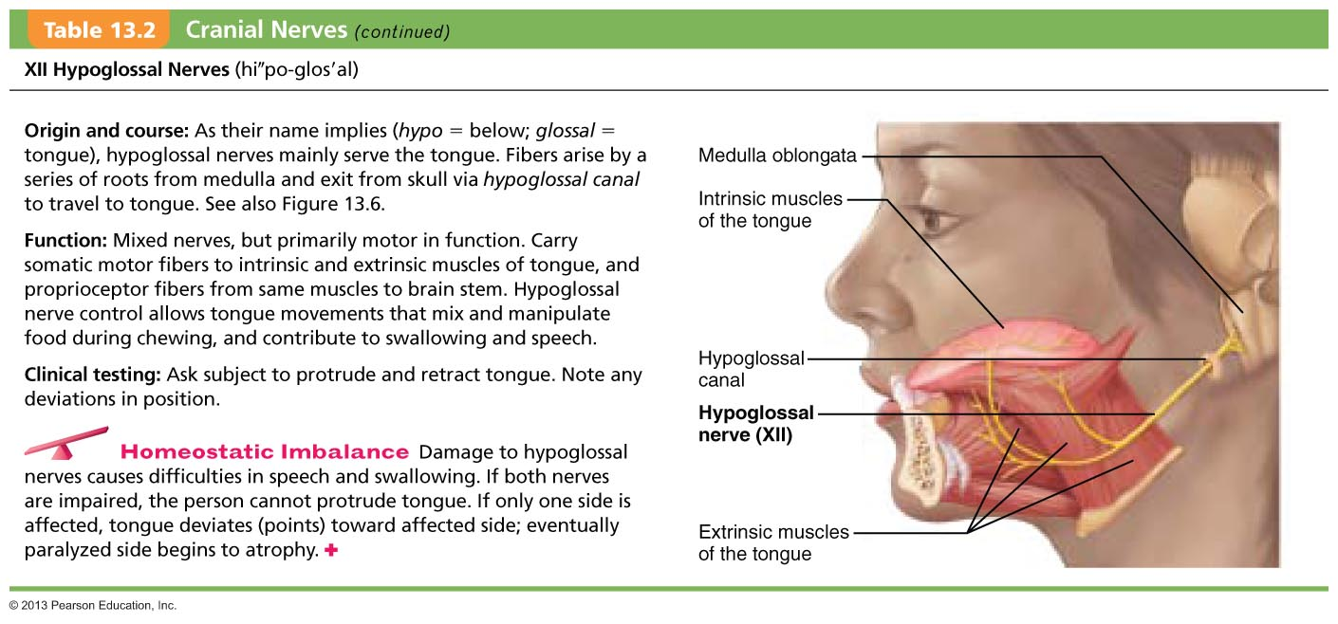
Table 13.2 Cranial Nerves (14 of 14)

Slide 31
Composition of Cranial Nerves
Olfactory and optic nerves
  Neuron cell bodies within special sense organs
Other nerves with sensory information (V, VII, IX, X)
  Neuron cell bodies in cranial sensory ganglia

Slide 32
Composition of Cranial Nerves
Some mixed nerves contain both somatic and autonomic fibers
  Most motor neuron cell bodies in ventral gray matter of brain stem
  Some autonomic motor neurons in ganglia
To remember primary functions of cranial nerves as sensory, motor, both:
  "Some say marry money, but my brother believes (it’s) bad business (to) marry money."

